Slide 1
Single-Source Shortest Path

Slide 2
Problem
A motorist wishes to find the shortest possible route from Islamabad to Lahore.
Route map is given where distance between each pair of adjacent intersections is marked.
One possible way is to enumerate all the routes from Islamabad to Lahore, add up the distance on each route and select the shortest.
There are hundreds and thousands of possibilities, most of them are simply not worth considering.

Slide 3
Contd…
A route from Islamabad to Peshawar to Lahore is obviously a poor choice, as Peshawar is hundreds of miles out of the way.
In this lecture, we show how to solve such problems efficiently.

Slide 4
Shortest path problem
We are given a weighted, directed graph G=(V,E), with weight function w:E->R mapping edges to real-valued weights.
The weight of path p=<v₀,v₁,…v_{k}> is the sum of the weights of its constituent edge.

Slide 5
Variants
Single source shortest path problem
Single destination shortest path problem
Single pair shortest path problem
All pairs shortest path problem.

Slide 6
Negative Weight edges
Sometimes, there may be edges whose weights are negative.
If the graph contains no negative-weight cycles reachable from the source, then shortest path weight are well defined.
If there is a negative weight cycle reachable from s, shortest-path weights are NOT well defined.
No path from s to a vertex on the cycle be a shortest path, a lesser path can always be found.
If there is a negative weight cycle on some path from s to v, we define it equal to infinity.

Slide 7
Example
s
c
6
5
d
0
11
5
-3
2
e
f
3
inf
inf
-6
There are infinite many paths from s to c, <s,c>, <s,c,d,c>, <s,c,d,c,d,c> etc.
δ(s,c)=5 and reason is that weight of cycle
<c,d,c> is 6+(-3)= 3 > 0, so shortest path is <s,c>=5
For cycle <e,f,e> the weight is 3+(-6)= -3 < 0, so path <s,e> is not shortest as
weight(s,e)=2, weigth(s,e,f,e)=-1, weigth(s,e,f,e,f,e)=-4…and so on.
So the δ(s,e)=infinity.

Slide 8
Single-Source Shortest Path
Problem: given a weighted directed graph G, find the minimum-weight path from a given source vertex s to another vertex v
“Shortest-path” = minimum weight
Weight of path is sum of edges

Slide 9
Shortest Path Properties
Define δ(u,v) to be the weight of the shortest path from u to v
Shortest paths satisfy the triangle inequality: δ(u,v) ≤ δ(u,x) + δ(x,v)
“Proof”:
x
u
v
This path is no longer than any other path

Slide 10
Shortest Path Properties
In graphs with negative weight cycles, some shortest paths will not exist (Why?):
< 0

Slide 11
Relaxation
A key technique in shortest path algorithms is relaxation
Idea: for all v, maintain upper bound d[v] on δ(s,v)
The process consists of testing whether we can improve the shortest path to v found so far by going through u.
If so, updating d[v] .
A relaxation step may decrease the value of the shortest path estimate d[v].

Slide 12
Relaxation
The following code performs a relaxation step on edge (u, v).
Relax(u,v,w) {
if (d[v] > d[u]+w) then d[v]=d[u]+w;
}
5
2
9
5
2
6
Relax
Relax
5
2
7
5
2
6
d[v] decreases d[v] unchanged

Slide 13
Dijkstra’s Algorithm
Similar to breadth-first search
Grow a tree gradually, advancing from vertices taken from a queue
Also similar to Prim’s algorithm for MST
Use a priority queue keyed on d[v]

Slide 14
Dijkstra’s Algorithm
B
Dijkstra(G)
for each v ∈ V
d[v] = ∞;
d[s] = 0; S = ∅; Q = V;
while (Q ≠ ∅)
u = ExtractMin(Q);
S = S U {u};
for each v ∈ u->Adj[]
if (d[v] > d[u]+w(u,v))
d[v] = d[u]+w(u,v);
10
2
A
4
3
D
5
C
1
Ex: run the algorithm
Relaxation Step
Note: this is really a call to Q->DecreaseKey()

Slide 15
B
10
2
A
4
3
D
5
C
1
Ex: run the algorithm

Slide 16
Dijkstra’s Algorithm
Dijkstra(G)
for each v ∈ V
d[v] = ∞;
d[s] = 0; S = ∅; Q = V;
while (Q ≠ ∅)
u = ExtractMin(Q);
S = S U {u};
for each v ∈ u->Adj[]
if (d[v] > d[u]+w(u,v))
d[v] = d[u]+w(u,v);
How many times is ExtractMin() called?
How many times is DecraseKey() called?
What will be the total running time?

Slide 17
Dijkstra’s Algorithm
Dijkstra(G)
for each v ∈ V
d[v] = ∞;
d[s] = 0; S = ∅; Q = V;
while (Q ≠ ∅)
u = ExtractMin(Q);
S = S U {u};
for each v ∈ u->Adj[]
if (d[v] > d[u]+w(u,v))
d[v] = d[u]+w(u,v);
How many times is ExtractMin() called?
How many times is DecraseKey() called?
A: O(E lg V) using binary heap for Q
Can acheive O(V lg V + E) with Fibonacci heaps

Slide 18
Dijkstra’s Algorithm
Dijkstra(G)
for each v ∈ V
d[v] = ∞;
d[s] = 0; S = ∅; Q = V;
while (Q ≠ ∅)
u = ExtractMin(Q);
S = S U{u};
for each v ∈ u->Adj[]
if (d[v] > d[u]+w(u,v))
d[v] = d[u]+w(u,v);
Correctness: we must show that when u is removed from Q, it has already converged

Slide 19
Shortest Path
Bellman Ford Algorithms

Slide 20
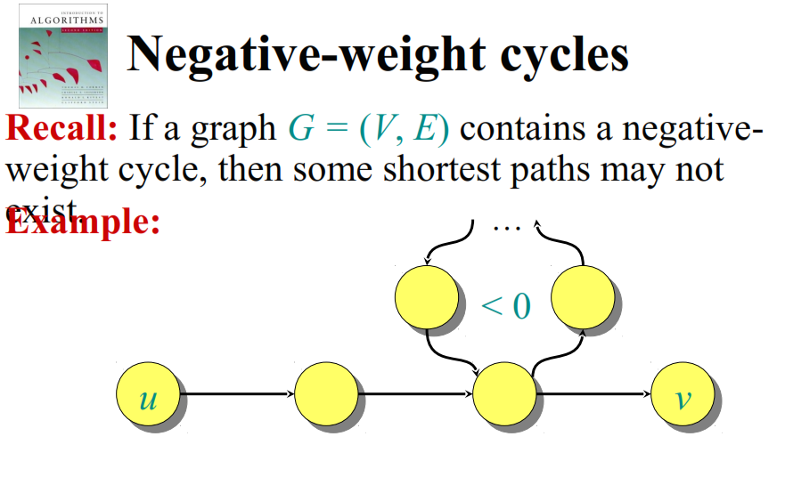

Slide 21
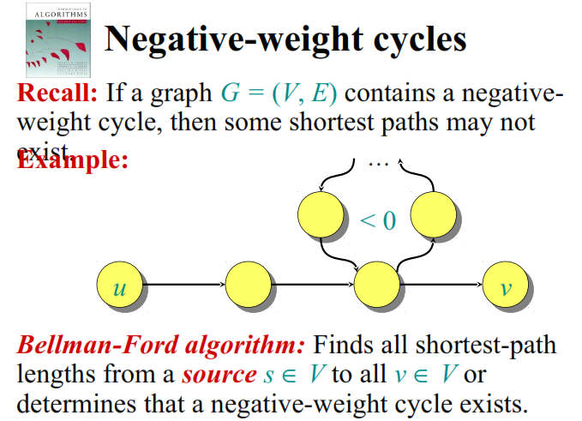

Slide 22
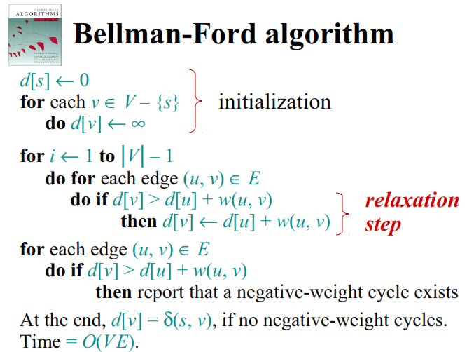

Slide 23
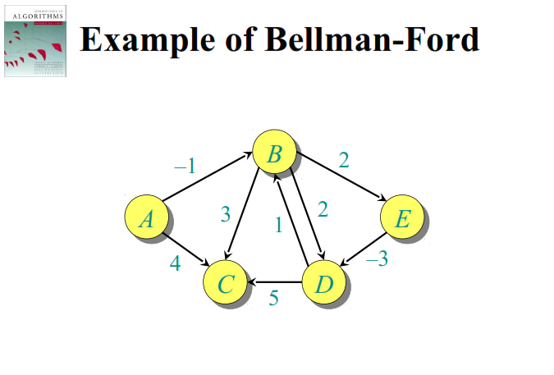

Slide 24
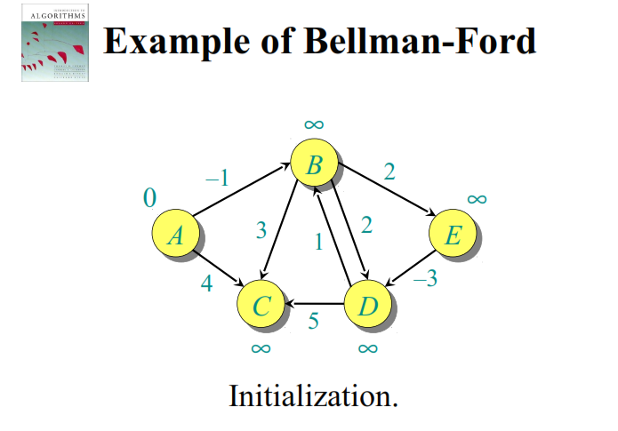

Slide 25
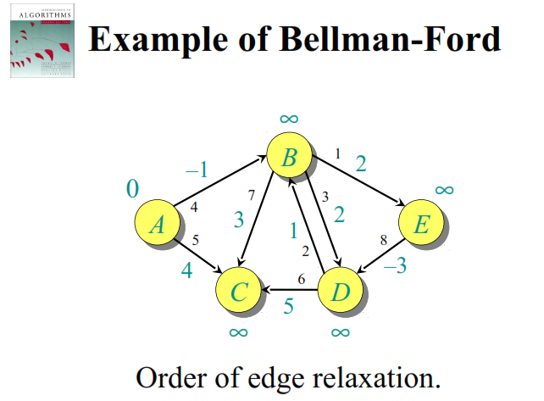

Slide 26
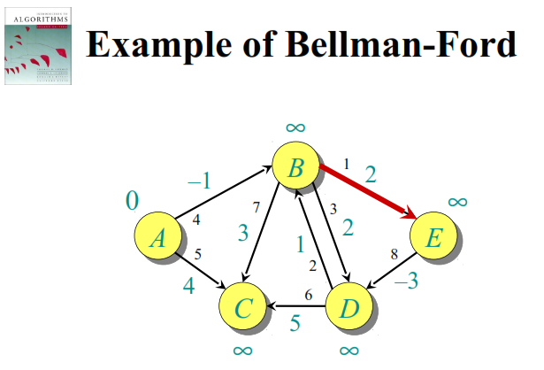

Slide 27
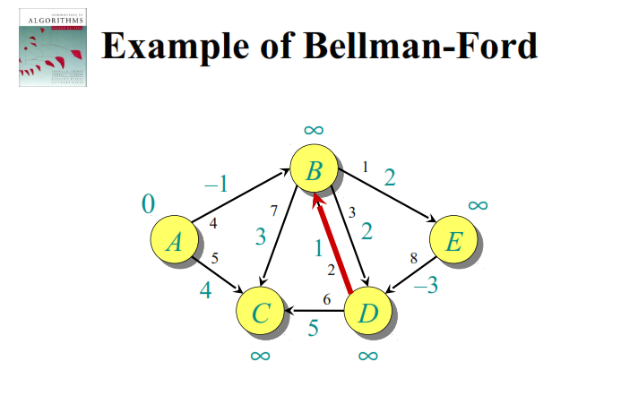

Slide 28
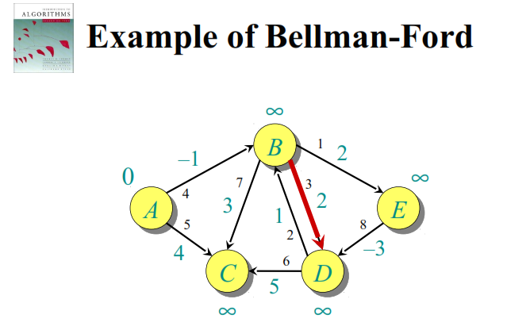

Slide 29
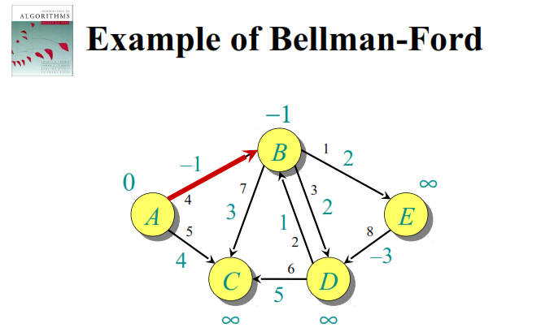

Slide 30
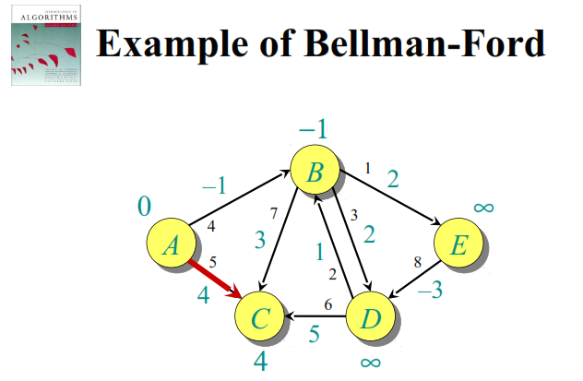

Slide 31
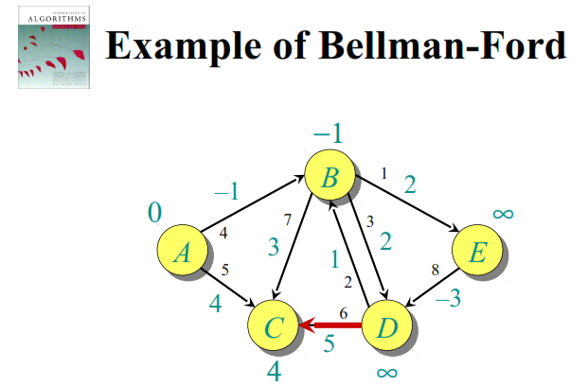

Slide 32
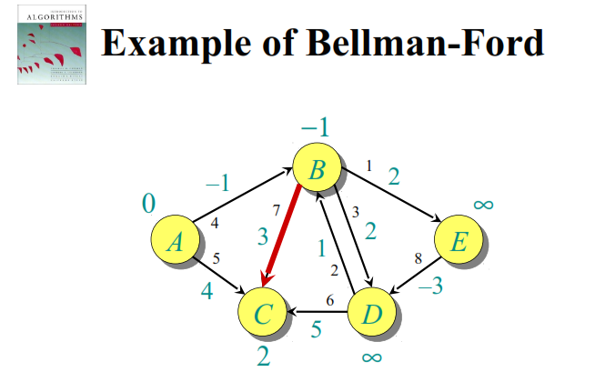

Slide 33
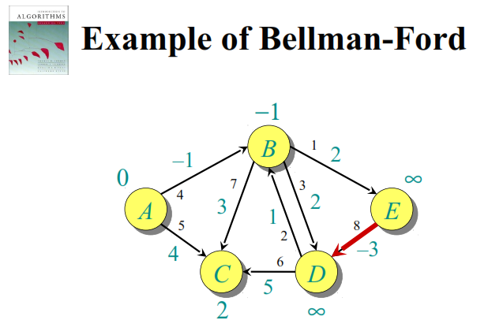

Slide 34
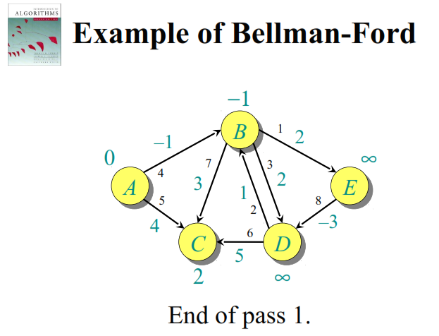

Slide 35
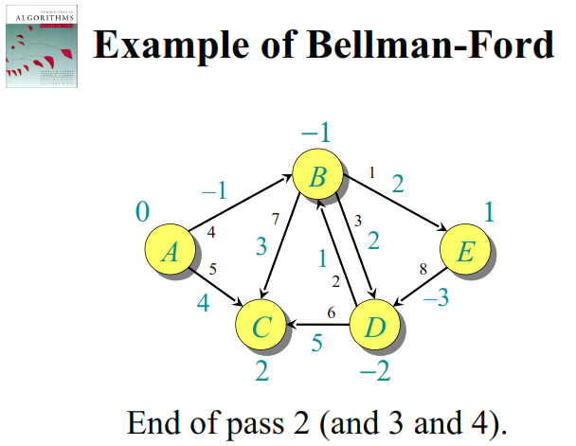

Slide 36
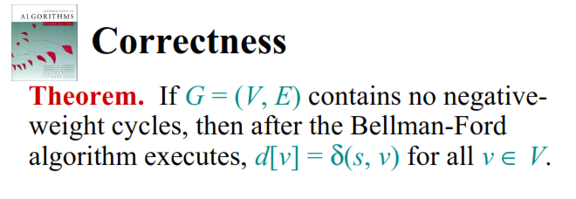

Slide 37
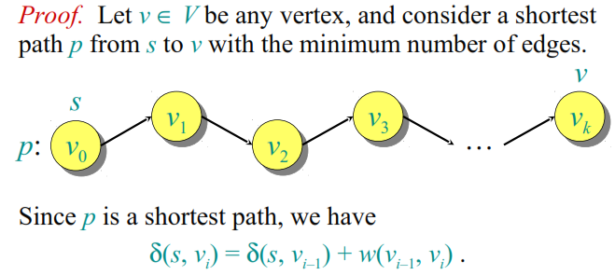

Slide 38
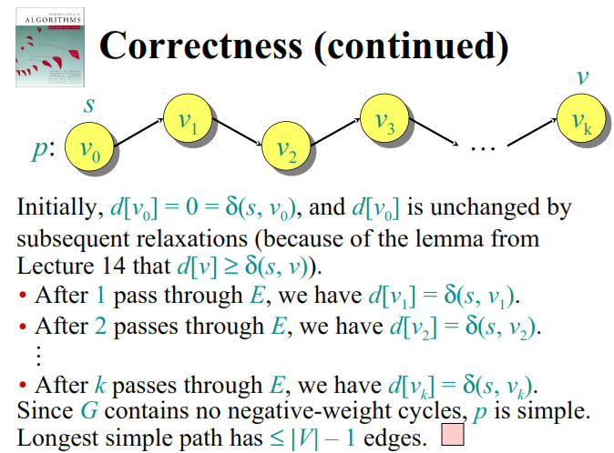

Slide 39
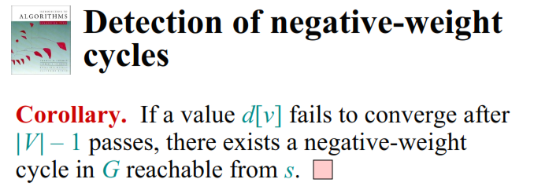

Slide 40
???????

